Slide 1
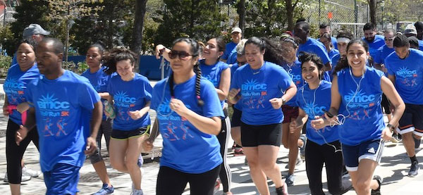
BMCC Couch to 5k
”Start Your Fitness Journey!”

Slide 2
BMCC Couch to 5k Orientation/Workout
Thank you to Health Ed. Professors for attending! Give a shout-out to your Professor!
Chat Questions: Are you interested in improving your health/fitness over the next few months? What type of exercise/activity are you currently doing?

Slide 3
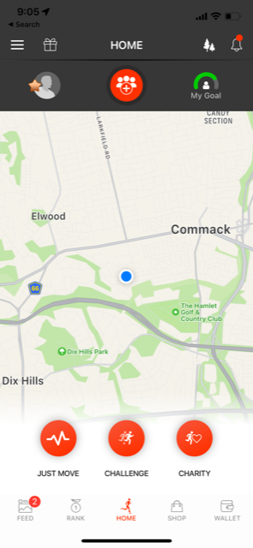
Group Invitation (phone/mobile device) https://justmoveapp.app.link/QsaP4SNartb

Slide 4
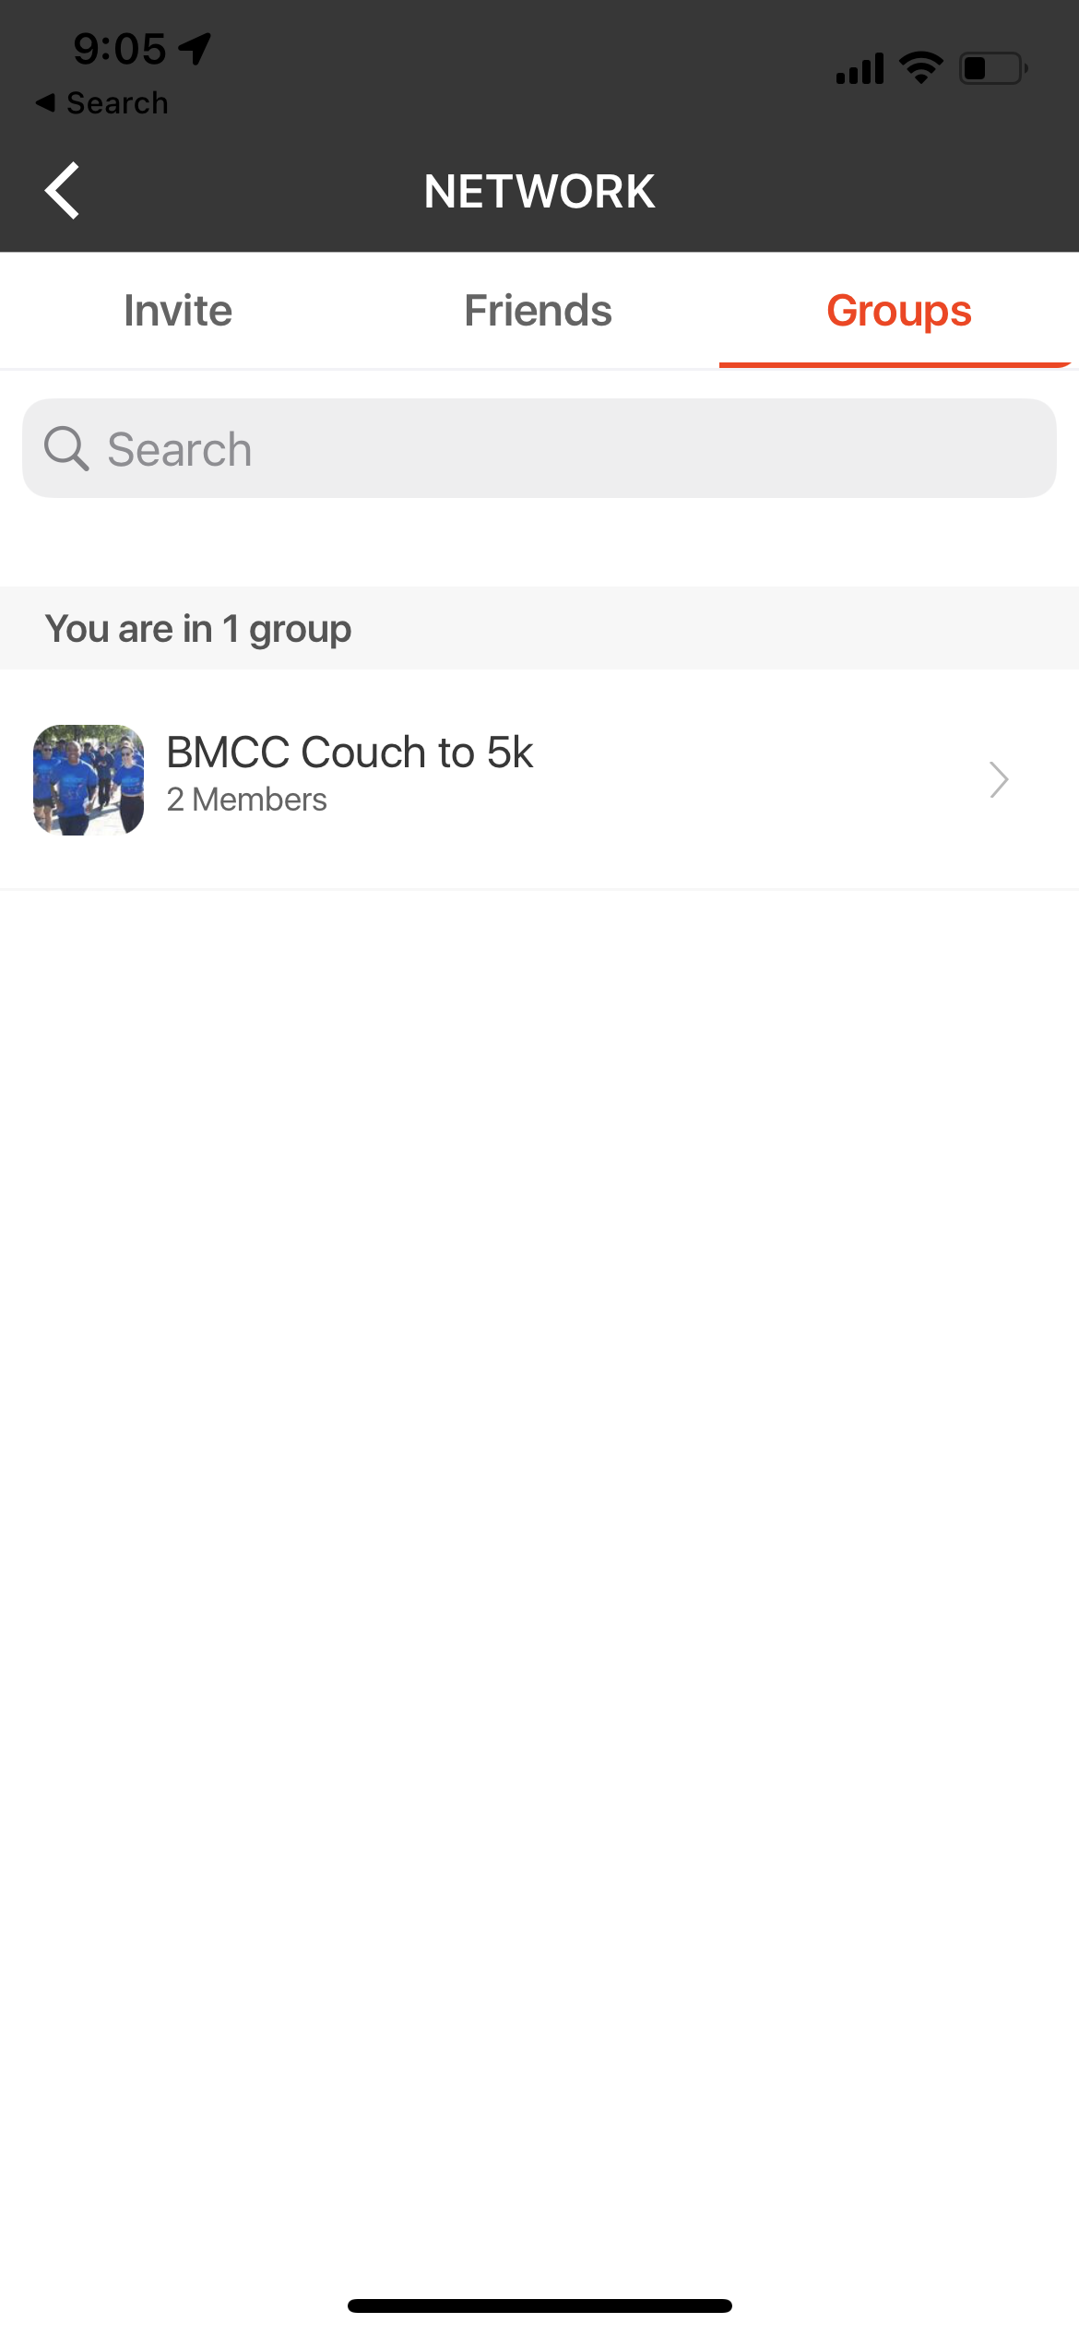
Under “Groups” you will see the BMCC Couch to 5k Group!

Slide 5
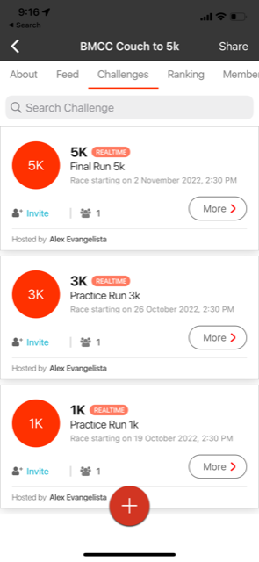
Make sure to join each race!

Slide 6
You are all set! On the day of the race, open the app and the event will begin automatically!

Slide 7
Stay connected & motivated on the Whatsapp group!
Fall 2022 Couch to 5k!
https://chat.whatsapp.com/KqGJmTdOa2P5b9eaZ1OuuQ

Slide 8
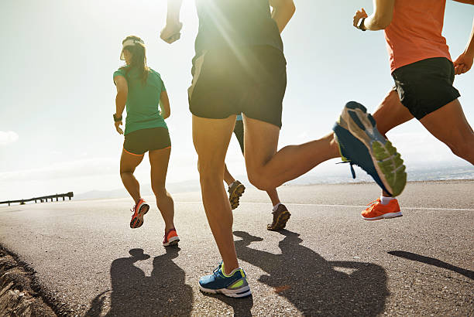
Couch to 5k Coaches!
If you love fitness/health we want your help!
Represent your area/borough!
Provide your Whatsapp link on the Couch to 5k Group so you can meet-up with others & run/walk together!
During the 5k race, groups of two or more who take a picture running/walking together can earn a gift. You will need to email pic & group names/emails.
Park Ideas:
Queens: Flushing Meadows Corona Park
Bronx: Van Cortlandt Park
Brooklyn: Prospect Park
Manhattan: Central Park
Staten Island: Great Kills Park

Slide 9
Couch to 5k Shirts will be available for pick-up after the 3k race, leading up to the 5k.

Slide 10
Need Some Motivation?
Lyn Thomas (Public Health Degree, Graduated Spring 2022)

Slide 11
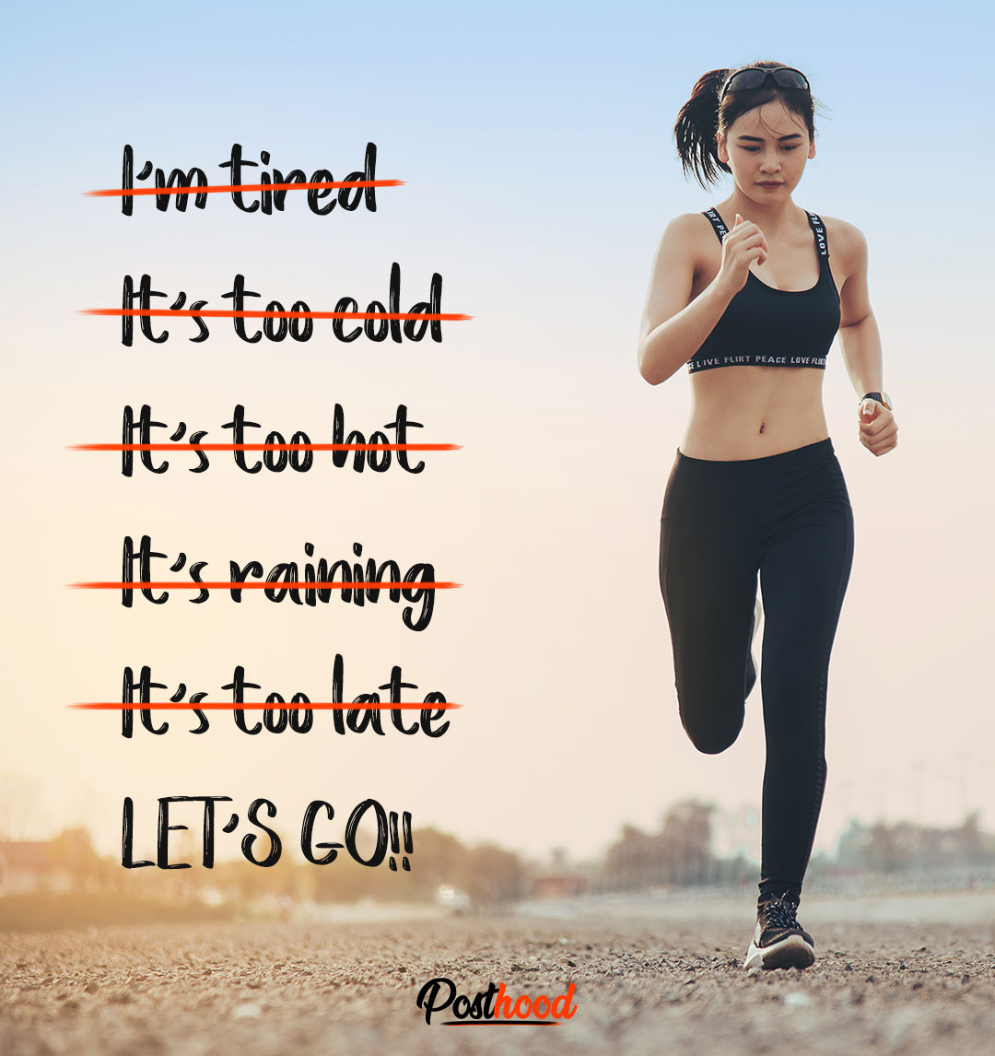
Make small changes to improve your health! (ask a Professor!)
Exercise/Activity (daily sweat)
Nutrition
(drink more water)
Sleep
(6-8hrs?)

Slide 12
https://runningoverload.com/wp-content/uploads/2020/09/Training-plans-C25K.pdf

Slide 13
Let’s do a quick workout that you can do anywhere!
Stretches (10sec each)
Cross chest arm stretch
Lat stretch
Trunk rotations
Lower back extensions
Hamstring Stretch
Quad Stretch
Calf Stretch
Exercises: (30sec each) (10sec active rest in between)
Jog in place
High knees
Squat with a kick
Jumping jacks
Ice Skaters
Lunges
Touch & jumps
R/L Knee thrusters
Butt kicks
Sprint!

